Slide 1

DSC 630 Project Final Presentation Income as it relates to individual characteristics
Lara Clasen
Bellevue University
Notes:
Hello, this is my final project presentation for the Predictive Analytics course at Bellevue University.

Slide 2
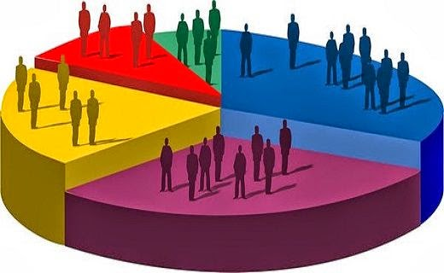

Selected data
Notes:
For my project I have selected an income data set provided by the United States Census. This data set contains information for U.S. adults and is derived from the 1994 Census database. It consists of anonymous descriptor data such as race, education, and occupation, as well as income level as less than or greater than $50,000 per year. The original data set contains both categorical and continuous features.
I selected this data set for a few reasons. First, I felt that the United States Census was a reliable source of data. This data set is almost certain to have been collected following appropriate guidelines and contains relevant and accurate values. Another reason I selected this data set is that analysis of this data can produce some very interesting outcomes. Income disparities in our country are a prevalent topic for discussion and analysis of income as it relates to various characteristics, such as the ones included in this data set, can help to offer some very sought-after answers.

Slide 3
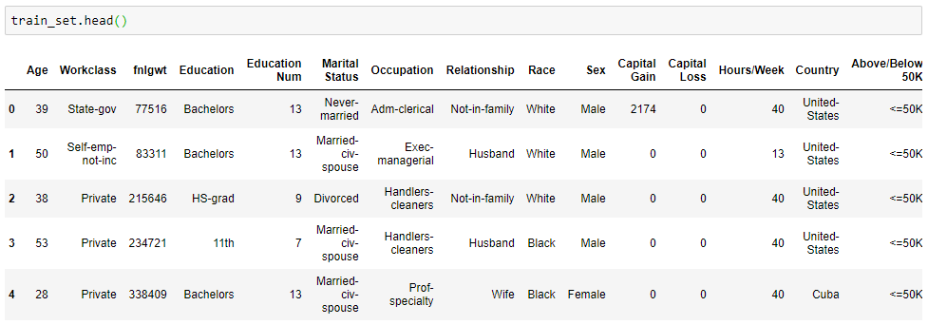
Income Data training set
Notes:
First, we take a look at our two provided data sets. The first data set is the training set. By calling head we can see the first several rows and their associated columns. We can see the final column which lets us know if the row fits into above or below $50K per year income.

Slide 4
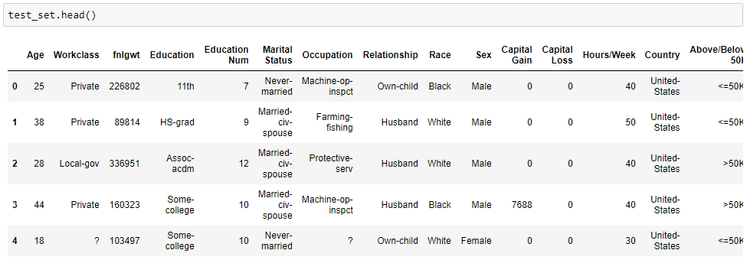
Income Data test set
Notes:
Next, we look at the first several rows of our test set for this data. We can see identical columns for this set.

Slide 5
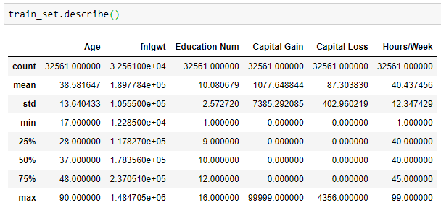
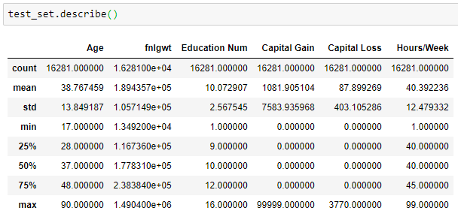
Summary statistics for each set
Notes:
By running summary statistics for each set, we can see general information and how each set compares to the other. The averages are clearly very similar to one another, which makes sense since they are pulled from the same original data set.

Slide 6
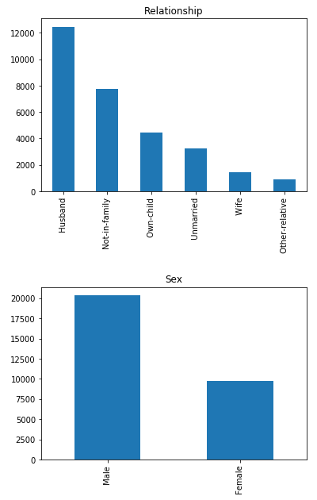
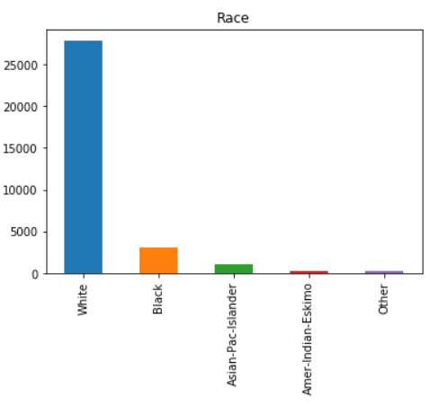
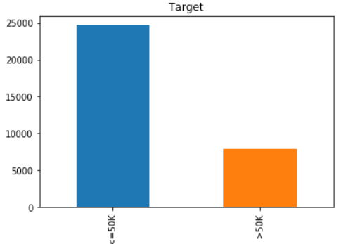
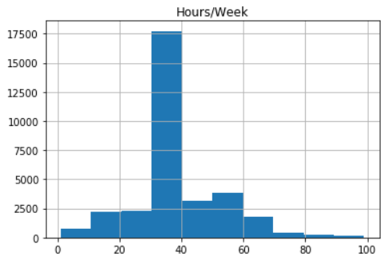
Data Visualization
Relationship
Race
Income Level
(Target Variable)
Gender
Hours per Week
Notes:
We can look at some visualizations of our variables. The histograms presented here are Relationship, Gender, Race, Hours worked per week, and our target variable, income level.

Slide 7
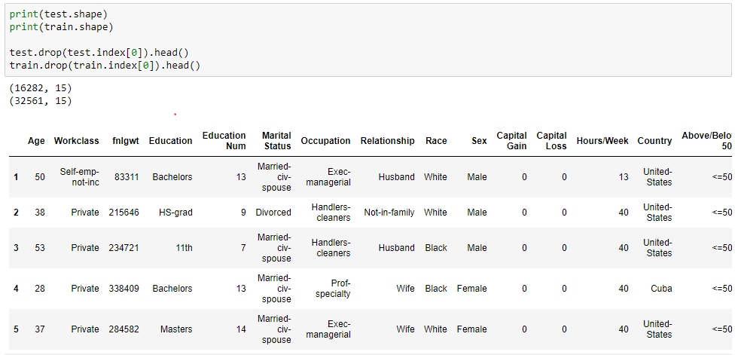
Begin to clean up data sets
Notes:
In this step we have deleted the first rows of the both dataframes since these are erroneous. We can now work with the data without involving the first rows of each.

Slide 8
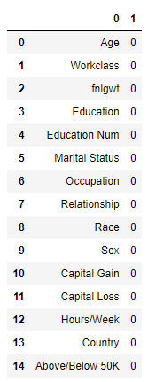
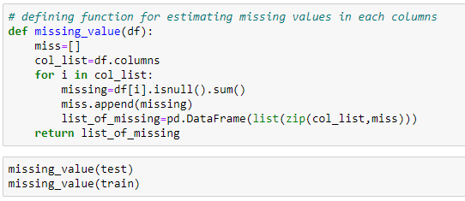
Cleaning step: search for any missing values
Notes:
We write a function to search for any missing values and report back the number found. We see that there exist no missing values by our criteria within the data set.

Slide 9
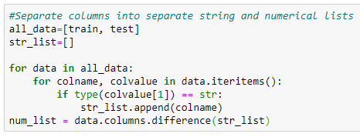
Cleaning step: separate strings and numerical variables
Notes:
In this step we use a tool to separate string values and numerical values into their own lists.

Slide 10
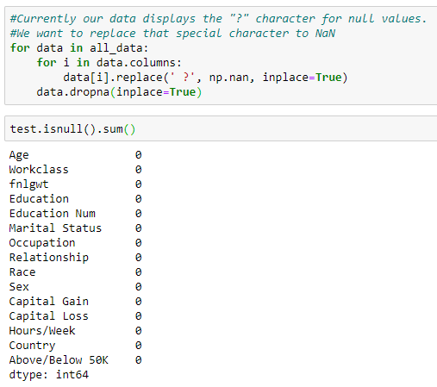
Cleaning step: remove “?” character for null values
Notes:
Looking at the unique values for our categorical columns, we can see that there exists a special character in the form of a question mark. We replace the special characters with NaN values and then delete the NaN rows. We can see that the result reveals we no longer have any null values in our data.

Slide 11
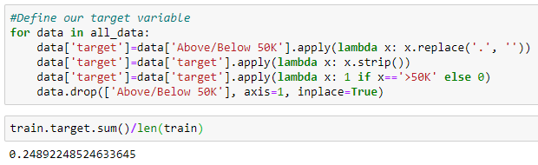
Define target variable
Notes:
Now we move into some feature engineering. Here we define our target variable as the Income Level variable. By looking at our data, we can also see that the Education and Hours per Week variables appear to be reliable variables to predict income.

Slide 12
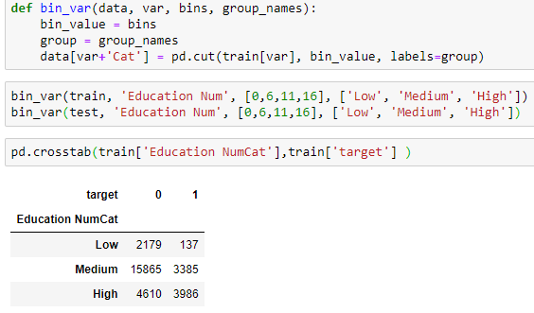
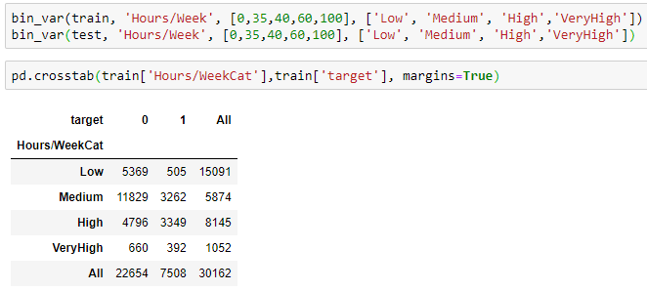
Alter columns by binning
Hours/Week
Education
Notes:
We can simplify our analysis a bit by “binning” some of our variables into groups. The Education variable can be binned into level of education within three groups: Low, Medium, and High. Similarly, we can bin the Hours per Week variable into levels of number of hours per week worked. Initial exploration suggests that 40 hours is the most frequent value, which is equivalent to a 40-hour work week. We will bin this variable around our most frequent value and from there we will bin into Low, Medium, High, and VeryHigh.

Slide 13
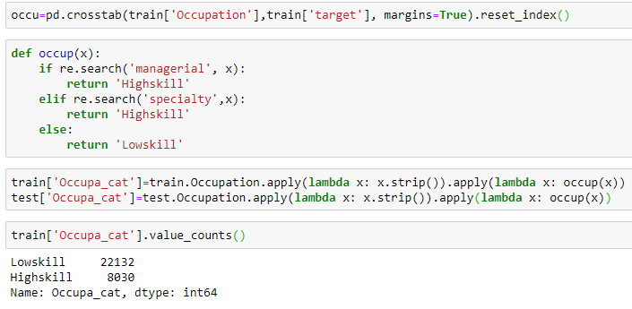
Alter columns by binning
Occupation can be classified by skill level.
Notes:
We can classify our Occupation variable by level as well, breaking it down by skill level. We come up with Lowskill and Highskill bins by separating based on managerial or specialty roles.

Slide 14
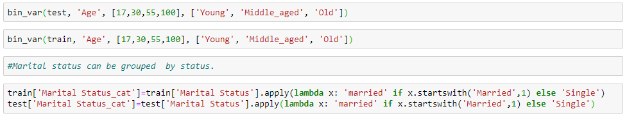
Alter columns by binning
Age and Marital Status can be grouped into levels as well.
Notes:
Age and Marital Status can be binned as well. With Age, we know that the minimum age is 17 and the maximum age is 90. We can categorize them as Young, Middle Aged, and Old based on these numbers. Marital Status is a bit easier to classify since we already have set levels for this variable.

Slide 15
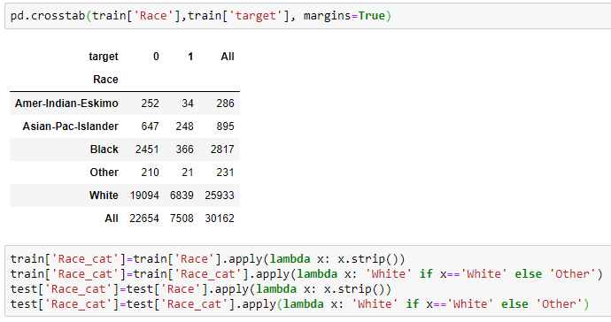
Alter columns by binning
Notes:
We are able to bin the Race variable so that it is separated into fewer groups than the original data set contains.

Slide 16
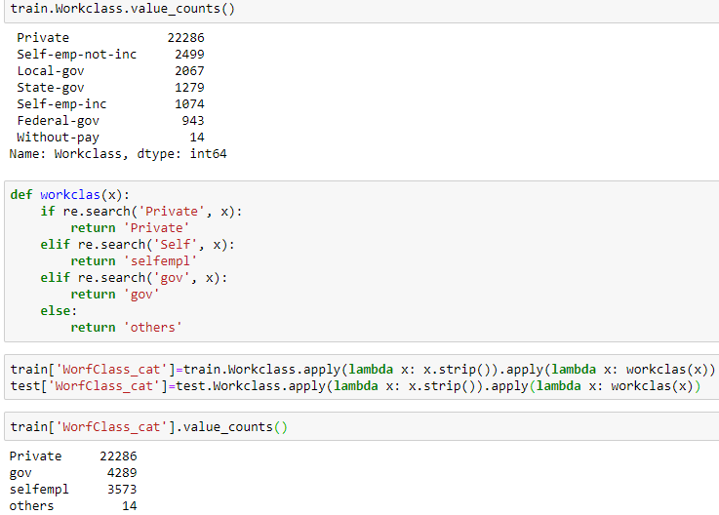
Alter columns by binning
Notes:
Finally, we can further reduce the Workclass variable into a few distinct groups: Private, Selfemployed, Government, and others

Slide 17
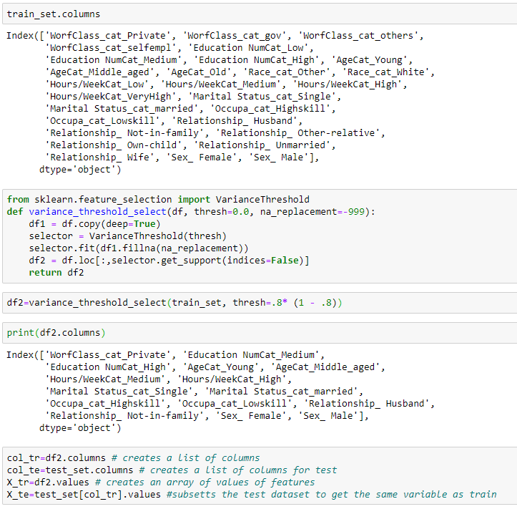
Feature selection using variance threshold
Notes:
Variance Threshold allows us to remove features where the variance doesn’t meet a certain threshold. It removes all zero-variance features, so those that have the same value in all samples. For our data we are aiming to remove variables which have more than 80% values that are either 0 or 1.

Slide 18
Feature selection using variance threshold
Notes:
The number of our columns have been reduced to 15 because of the specified variance threshold. The removed columns had the same value in 80% of the observations.

Slide 19
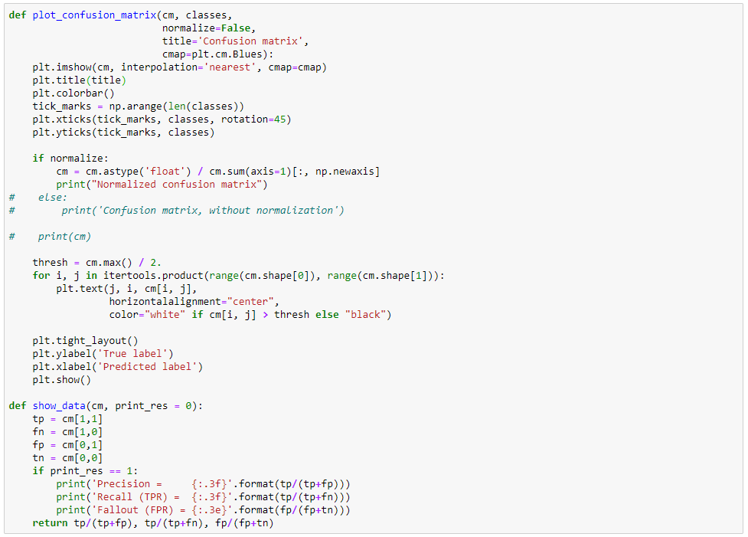
Next up: Modeling the data
Notes:
We are going to create a confusion matrix for our data.

Slide 20
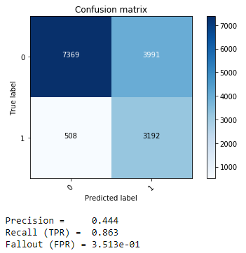
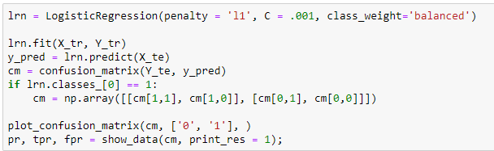
Modeling the data
Notes:
Precision of the confusion matrix is the ability of a classification model to identify only the relevant data points. Precision is defined as the number of true positives divided by the number of true positives, plus the number of false positives. False positives are cases which the model incorrectly labels as positive that are actually negative. Recall is the ability of a model to find all of the relevant cases within a dataset. While Recall expresses the ability to find all relevant instances in a dataset, Precision expresses the proportion of the data points our model says was relevant actually were relevant. Our Recall here is .863 which is fairly good. However, our Precision is just .444 which shows room for improvement.

Slide 21
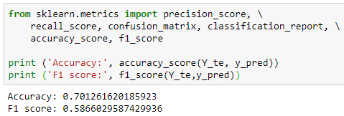
Modeling the data
Notes:
We have achieved an accuracy of 70%, which is actually quite good.

Slide 22
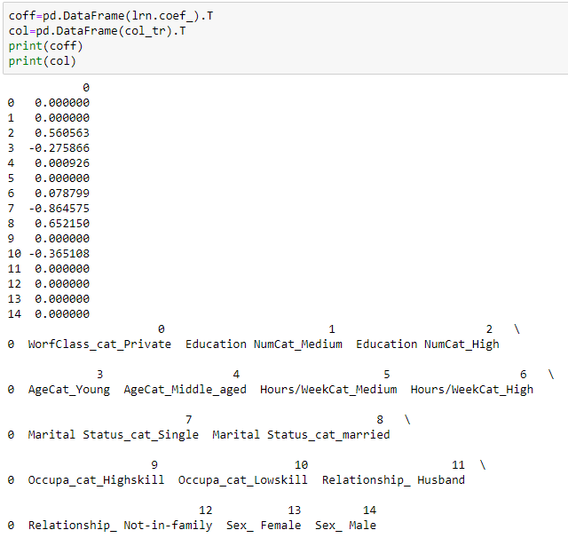
Understanding coefficients
Notes:
In this step we attempt to understand important features for High and Low Paying Jobs. We can see that positive coefficients are for high paying and negative coefficients are for low paying jobs. A High number of years of education along with high work hours per week are important for obtaining high income.

Slide 23
Conclusions
Education Level
Hours per Week
Income Level
Notes:
Overall, we can confidently say that several of our included characteristics play an important role in predicting income level. Specifically, Education Level and Hours Worked Per Week can pretty accurately predict income level. This is valuable information, however, in my opinion these variables in a way confound the results. Of course we are likely to see that Hours Worked Per Week directly contribute to higher income level, as there is a direct and mathematically understandable link between the two. However, the variables such as Race or Marital Status are more interesting variables to compare. For this reason I would choose to remove the more obviously connected variables from this data set if I were to run my analysis again. This way we would be more likely to see lesser known links between unexpected variables and income level, which is a more valuable result for society.

